Slide 1
Keywords, Identifiers, Data Types and Qualifiers
Rakib Mahmud

Slide 2
Keywords
Keywords are predefined or reserved words that have special meanings to the compiler.
These are part of the syntax and cannot be used as identifiers in the program.
In C programming there are 32 keywords.
Example:
if, else, while, for etc.

Slide 3
Identifier
Identifier are user defined words.
Example:
Variable name
Function name
Array name
Structure name etc

Slide 4
Rules to name an identifier
An identifier can include letters and digit.
An identifier can only begin with letters or underscore ( _ )
An identifier can’t include special character except underscore ( _ )
Spaces are not allowed while naming an identifier.
We can not name identifiers the same as keyword.
C language is case sensitive. For example xyz, XYZ these two variables are different.

Slide 5
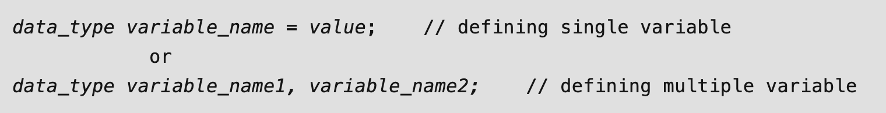
Variable
A variable in C language is the name associated with some memory location to store data of different types.
Syntax:
Example:
int a = 5; # it means you can declare a variable and assigning the value
int b; # You can also declare a variable without assigning the value
b = 10; # Then assign the value later

Slide 6
Data Types
It specifies the type of data that the variable can store.
It tells how much storage/memory to be allocated to a variable.
Mainly 3 types. They are:
Primary: int, float, char, double, void.
Derived: array, structure, union, pointers.
User-defined: typedef, enum

Slide 7

Integer Data Type
The integer datatype in C is used to store the integer numbers (any number including positive, negative and zero without decimal part).
Range: -32768 to +32767
Size: 2 bytes
Format Specifier: %d
Syntax:
The format specifier in C is used to tell the compiler
about the type of data to be printed or scanned in
input and output operations.

Slide 8

Character Data Type
Character data type allows its variable to store only a single character.
Range: (-128 to 127) or (0 to 255)
Size: 1 byte
Format Specifier: %c
Syntax:

Slide 9

Float Data Type
Float in C is used to store decimal and exponential values.
It is used to store decimal numbers (numbers with floating point values) with single precision.
Range: 1.2E-38 to 3.4E+38
Size: 4 bytes
Format Specifier: %f
Syntax:

Slide 10

Double Data Type
A Double data type in C is used to store decimal numbers (numbers with floating point values) with double precision.
Range: 1.7E-308 to 1.7E+308
Size: 8 bytes
Format Specifier: %lf
Syntax:

Slide 11
Qualifiers
The qualifiers are the keywords applied to the data types to change its meaning.
There are 3 types of qualifiers.
Size qualifier
Sign qualifier
Type qualifier

Slide 12
Size Qualifier
Size qualifier are prefixed to the basic data types to increase or decrease the space allocated to the variable.
In here there are 2 keywords (short, long)

Slide 13
Sign Qualifier
Sign qualifier is used to specify the signed nature of the integer.
In here there are 2 keywords. They are Signed, Unsigned
If nothing is mentiond then by default there will be signed qualifier.

Slide 14
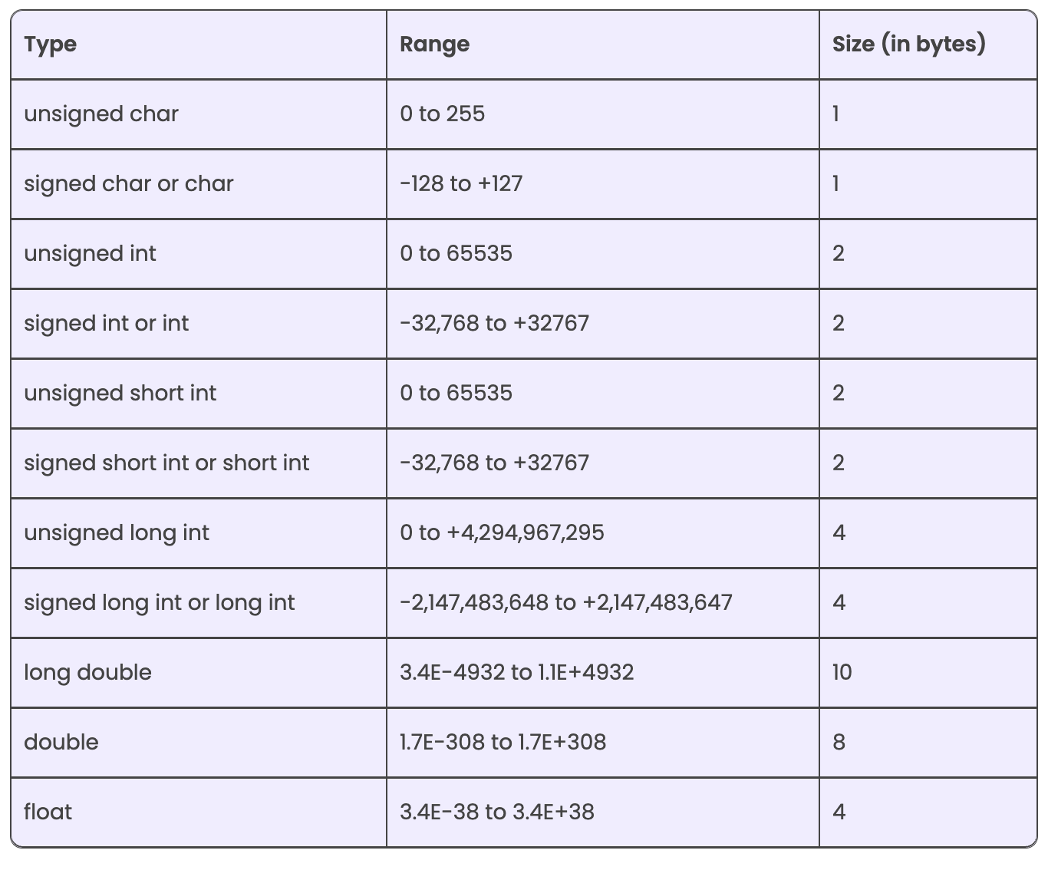
Qualifiers (Cont’d)

Slide 15
Type Qualifier
It tells who has the capability to modify the value of the variables.
In here we have const, volatile keywords.
 | Modify in Code | Modify through External Factor
int a=0; | Yes | No
const int a = 0; | No | No
volatile int a = 0; | Yes | Yes
const volatile int a = 0; | No | Yes

Slide 16
printf() and scanf() in C
The printf() and scanf() functions are used for input and output in C language.
The printf() function is used for output. It prints the given statement to the console.
The scanf() function is used for input. It reads the input data from the console.

Slide 17
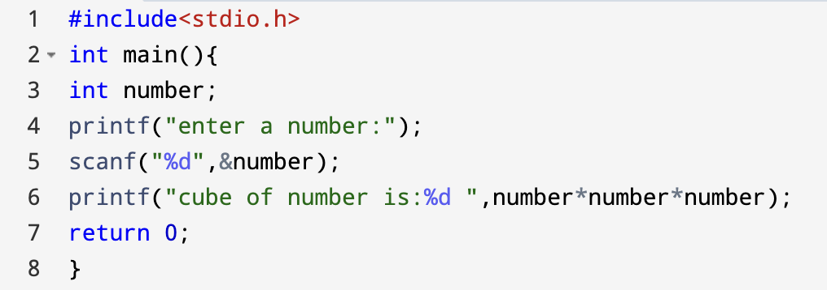
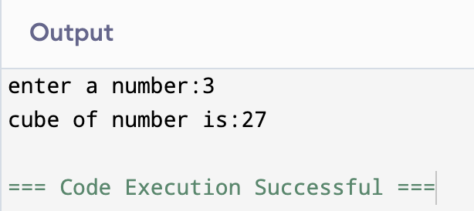
printf() and scanf() in C (Cont’d)

Slide 18
Thank You

